Slide 1
Online Flight Booking System

Slide 2
Introduction
In today's fast-paced world, travel has become an integral part of our lives.
Whether for business, leisure, or other purposes, the demand for air travel has surged significantly over the years.
With the advent of modern technology, the airline industry has witnessed a transformation, moving towards online booking systems to simplify the travel experience for passengers.
This paradigm shift has given rise to the development of the "Online Flight Booking System Project in Python and MySQL."

Slide 3
Purpose
The primary purpose of this project is to streamline the process of booking airline tickets and managing flight schedules.
It is designed to offer a user-friendly, efficient, and secure platform for both passengers and administrators to interact with flight information, make bookings, and manage flight operations.
The project's core objective is to provide an intuitive and convenient way for users to search for available flights, book tickets, make payments, and access essential flight information, including departure times, gate numbers, and seat details.

Slide 4
Scope
Client-Side Interaction: The system facilitates passenger interaction, allowing them to search for available flights, book tickets, make payments, and access flight details.
Admin Panel: Administrators have full control over the system, enabling them to manage flights, cities, bookings, and flight schedules.
Passenger Registration: Passengers can register on the platform to access features like booking tickets and viewing flight information.
Booking Airline Tickets: Passengers can book tickets for their desired flights after searching for available options.
Payment System: The system integrates a secure payment gateway for seamless transaction processing.
Search for Flights: Passengers can search for flights based on their departure and arrival locations, dates, class, and the number of passengers.
View E-Ticket: After booking, passengers can access and view their electronic tickets, which contain detailed flight information.
Cancel Tickets: Passengers have the option to cancel their bookings, and the system automates the ticket generation and cancellation processes.

Slide 5
Scope
Print Tickets: Users can print their tickets for reference or check-in at the airport.
Check Flight Status: Passengers can check the real-time status of their booked flights to stay informed about any delays or changes.
View Total Amount: The system provides a summary of the total amount paid for bookings.
List Today’s Flights: Administrators can monitor and manage flights scheduled for the current day.
Manage Flight’s Departure – Arrival: Admins can mark flights as departed or arrived based on their status.
Mark Flight Issues: In case of any flight-related issues, administrators can document and track them within the system.
Flight Management: The admin has the ability to manage flight schedules, airlines, and flight details, including departure and arrival times, locations, duration, prices, and airline information.

Slide 6
Technologies
Django: Django can be used for a more robust and scalable backend, providing built-in features for authentication, database operations, and an admin interface.
APIs: RESTful APIs can be developed using Django REST Framework (DRF) to facilitate communication between the client-side and server-side components.
MySQL: A relational database management system used to store and manage data related to flights, bookings, passengers, and other essential information.
SQLAlchemy: An ORM (Object-Relational Mapping) library for Python that facilitates database operations and interactions in a more Pythonic way.
HTML5: The standard markup language for creating web pages, providing the structure and content of the airline reservation system's web interface.
CSS3: Used for styling and designing the web pages to ensure a visually appealing and responsive user interface.
Bootstrap: A front-end framework that helps in creating responsive and mobile-first web pages quickly, with pre-designed components and utilities.

Slide 7
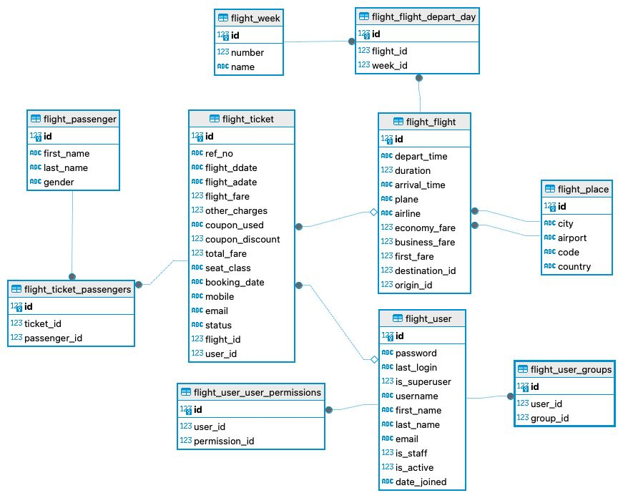
Entity-Relationship (ER) Diagram

Slide 8
System Overview
Three-Tier Architecture:
Presentation Layer (HTML, CSS, JavaScript, Bootstrap)
User Interface: Web pages, forms, and UI elements for bookings and management.
Application Layer (Python for server-side logic)
Server-Side Logic: Manages user requests, data processing, and database connection.
Data Layer (MySQL database)
MySQL Database: Stores flight schedules, passenger information, booking records, and more.

Slide 9
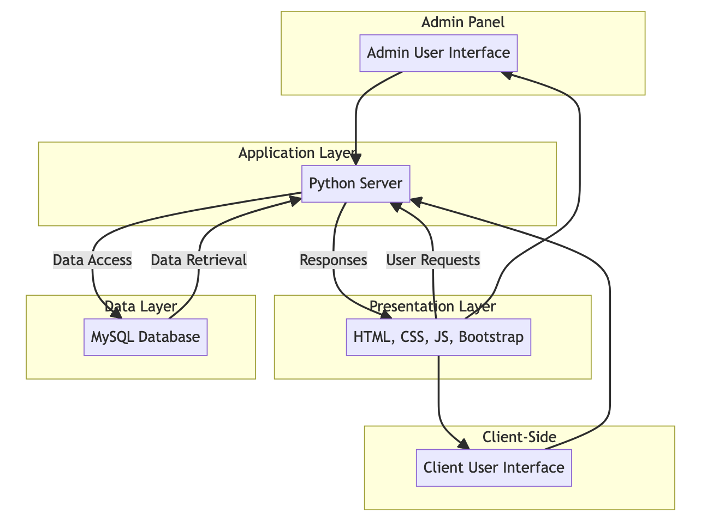
System Overview

Slide 10
Features
Client-Side Interaction:
User Registration: Account creation with personal information.
Booking Airline Tickets: Search flights, book tickets, and make payments.
View E-Ticket: Access electronic tickets with detailed flight information.
Cancel Tickets: Option to cancel bookings with automated refunds.
Print Tickets: Print tickets for airport check-in.
Check Flight Status: Real-time updates on flight status.
View Total Amount: Summary of the total amount paid for bookings.
Admin Panel Interaction:
Admin Panel Overview: Secure login for full system control.
Managing Flights: Create, update, and delete flight records.
Managing Cities and Airlines: Set up city locations and airline details.
Listing Booking Details: View and manage all booking records.
Handling Reservations: Track and manage passenger bookings.
Managing Flight Issues: Document and resolve flight-related issues.

Slide 11
Conclusion
The Online Flight Booking System Project in Python and MySQL represents a comprehensive and efficient solution for booking airline tickets and managing flight schedules.
Key Achievements
Streamlined Booking Process: The system offers passengers a user-friendly and convenient way to search for flights, book tickets, and make payments. It simplifies the traditionally complex process of airline ticket booking.
Efficient Flight Management: Administrators have access to a powerful admin panel that allows them to manage flight schedules, airlines, and booking records. This ensures accurate and up-to-date flight information for passengers.
Data Centralization: The system centralizes flight-related data, promoting efficient data management and retrieval, which is vital for airlines and administrators.
Cost Reduction: The adoption of an online booking system can reduce administrative and operational costs, making it a cost-effective solution for airlines.
Competitive Advantage: Airlines that offer an efficient online booking system gain a competitive edge by attracting more passengers.
Learning Resource: The project serves as a valuable learning resource for individuals interested in web development and database management, providing insights into creating similar systems.

Slide 12
Future Enhancements
Integration with Additional Services: Expanding the system to include hotel reservations, car rentals, and other travel-related services could offer passengers a more comprehensive travel booking experience.
Enhanced Reporting and Analytics: Developing robust reporting and analytics features for administrators could provide insights into booking trends, revenue analysis, and passenger behavior.
Mobile Application: Developing a mobile app version of the system can cater to the growing number of users who prefer to book flights and access travel information through mobile devices.
User Reviews and Ratings: Integrating a user review and rating system for flights and airlines can provide valuable feedback for both passengers and airlines.
Dynamic Pricing: Implementing dynamic pricing algorithms based on demand, time, and other factors can optimize revenue for airlines.
Multi-language and Currency Support: Expanding language and currency options can make the system accessible to a global audience.
Enhanced Security: Continuously improving and updating security measures to protect user and payment data is essential in today's digital environment.
Integration with Airlines' Reservation Systems: Integration with airlines' reservation systems can provide real-time flight information and booking options.

